Slide 1
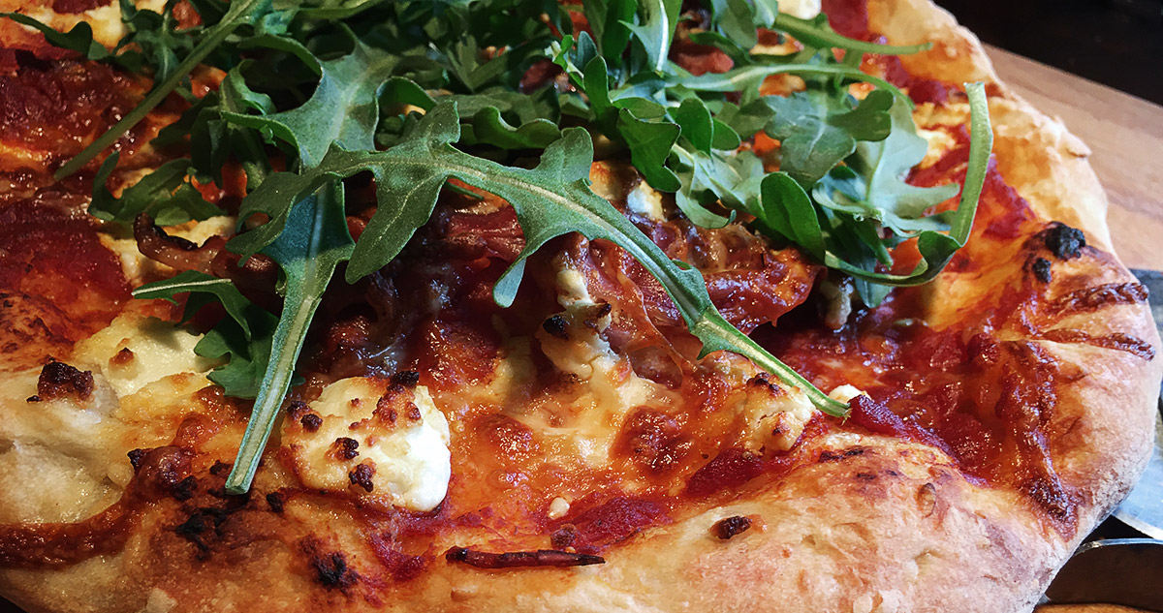
Nakisa Pizza Project
Saman Firouzi

Slide 2
Introduce of Saman Firouzi
2017
ADP: Java- Spring boot- JSF- PrimeFaces- MySQL- Apache Camel
2018
Faraz: Java- Spring boot- AngularJs- React Native- Maria DB- ElasticSearch
2019
DatX soft: Java- NodeJS- Spring Boot- MariaDB- RabbitMQ- ElasticSearch- SocketIO- ReactJs
2015
2012
2008
2009
Parsnip: Java- LibGDX- NodeJS- Oracle
Rayan Eghtsad Novin:
Java- Spring- Hibernate- JSF- PrimeFaces- Oracle- Android
Behpardaz Jahan: Java- Spring- Hibernate- JSF- RichFaces- Solr- ebXml- Oracle
National library and archive of iran:
Java- Oracle
2005
Pezhvak: Java- JSP- Struts- Oracle
Bachelor, Computer Software Engineering

Slide 3
Actors & activities
Guest access to ..
Visit main page
Visit lunch page
Customer access to ..
Include all the guest feature
Add order from all pages
Administrator access to ..
Include all both users' feature
Visit, add, edit configuration list
Visit promotion page
Visit side page
Visit drink page
Register as a customer
Search in products
Login page
Add or remove order from Cart list
Deactivate cart list
Merge the deactivate list to cart list
Remove from deactivate list
Send the cart list as a favorite
Pay the order from cart
Make a new cart list by favorite list
Visit detail of product
Visit detail of promotion
Read comments of products
Logout
Remove a favorite
Add/remove order from deactivated list
Visit all the user orders by type and id
Find products by name, type and id
Visit, add and edit products
Visit, add and edit promotions

Slide 4
Hidden futures
OAuth2 JWT
Event log
monitoring

Slide 5
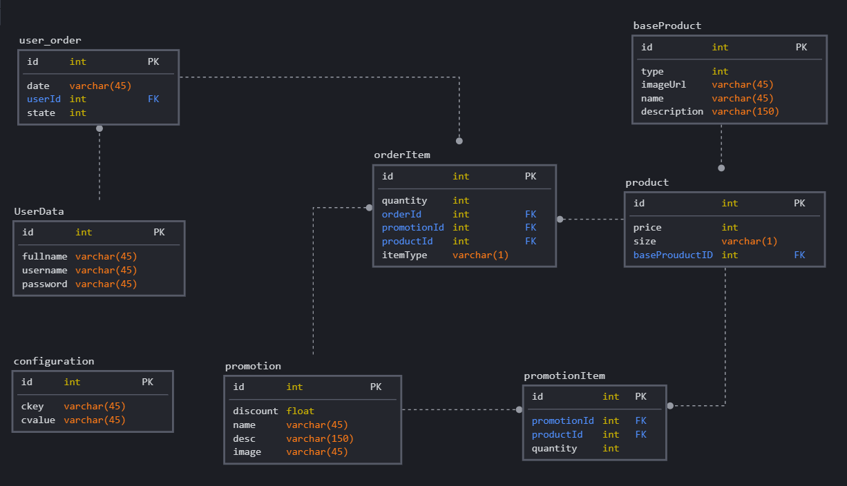
Data Diagram

Slide 6
Pizza Project Architecture
Pizza Web Front-end
Elasticsearch
Spring boot microservices
My SQL DB Server
Event logs
Comments
Reviews
Response if user allowed
Call rest APIs with JWT access token
Quasar Vue JS
Read Save Delete
Front-end
Spring boot OAuth2 server
Ask for permission with access token
Get Token – refresh token – revoke token
Upload & Download Resources
Resource server
Not yet

Slide 7
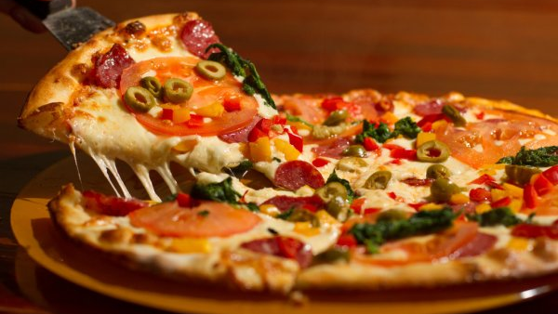
The END Nakisa Pizza Project
Saman Firouzi

